Slide 1

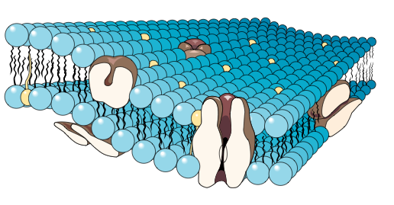

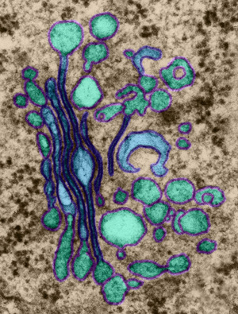

Cell Biology & Biochemistry Series:
Set 4
Version: 1.0

Slide 2
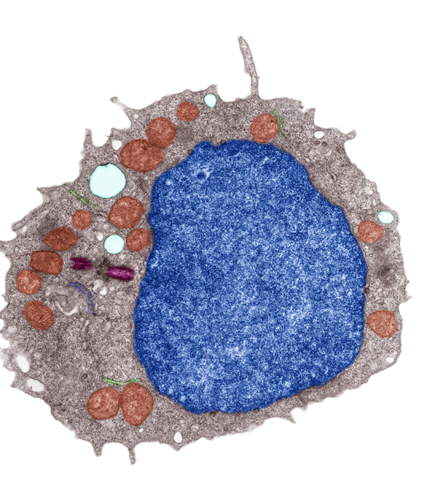
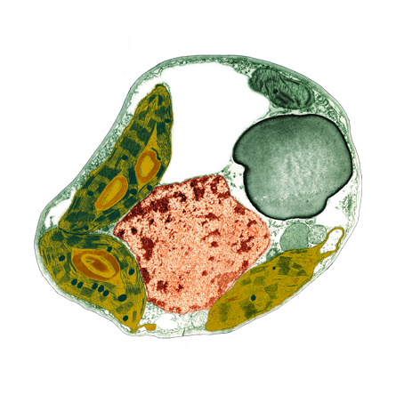

Cells and Membranes
Animal cell
The membrane surrounding a cell, called the plasma membrane, forms the boundary that separates the living cell from its non-living surroundings.
Although the plasma membrane (arrowed) is only about 8 nm thick, it:
  selectively controls the movement of materials into and out of the cell
  is responsible for cell-cell recognition (e.g. when cells aggregate into tissues
  is a dynamic structure, with distinct
  inside and outside faces.
Plant cell

Slide 3
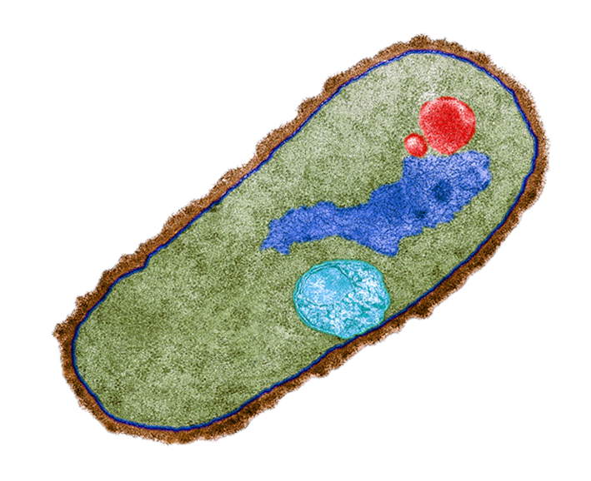
The Plasma Membrane
A plasma membrane is common to all cells.
It forms their outer limit.
Bacteria, fungi, and plant cells have a cell wall, but it is a structurally distinct feature and lies outside the
plasma membrane.
Plasma membrane
This colored Bacillus megaterium cell clearly shows the plasma membrane, which lies inside the distinct structure of the cell wall.
Cell wall

Slide 4

Membrane Structure
The currently accepted model for the structure of the plasma membrane (and cellular membranes generally) is the fluid mosaic model.
  In this model there is a double layer of phospholipids (fats),
  which are arranged with their hydrophobic tails facing inwards.
  The double layer of lipids is quite fluid, with proteins floating within it.
  Glycoproteins, glycolipids, and cholesterol are also an integral part of the membrane structure.
}
Double layer of phospholipids (lipid bilayer)
Hydrophilic end
Hydrophobic end

Slide 5
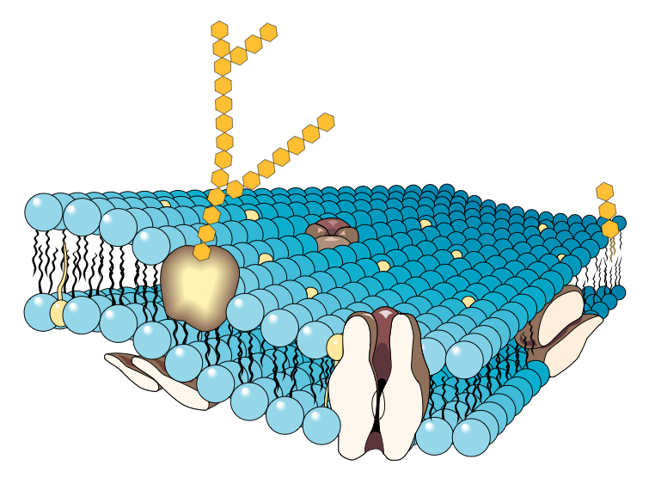
Membrane Structure
Glycoproteins play an important role in cellular recognition and immune responses. They help stabilize the membrane structure.
Glycolipids act as surface receptors and stabilize the membrane.
Some proteins, called peripheral proteins, are stuck to the surface of the membrane.
Some proteins completely penetrate the phospholipid layer. These proteins may control the movement of specific molecules into and out of the cell.

Slide 6
Membrane Structure
Glycolipids also have a role in helping cells to aggregate in the formation of tissues.
Cholesterol in the membrane disturbs the close packing of the phospholipids and keeps the membrane more fluid.
Some substances, including water, are transported directly through the phospholipid bilayer.
Some substances, particularly ions and carbohydrates, are transported across the membrane via the proteins.

Slide 7
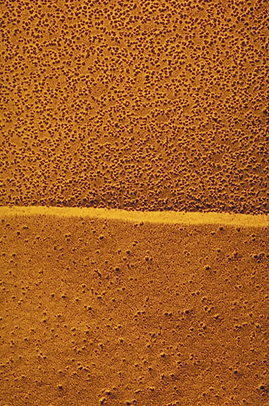
Evidence for the
Fluid Mosaic Model
Plasma
The invention of freeze fracture electron microscopy has played
a critical role in determining membrane structure.
The models revealed pitted areas amongst a smooth background.
  The “pits” were the indentations
  left by the embedded proteins within the phospholipid bilayer of
  the membrane.
  This evidence gave support to the fluid mosaic membrane model.
P face
(internal membrane layer)
A freeze fractured erythrocyte (red blood cell) membrane magnified 120,000 times by SEM.
E face
(external membrane layer)

Slide 8
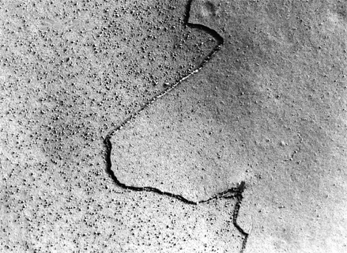
Freeze Fracture Technique
The sample is frozen in liquid nitrogen.
The sample is cut, breaking along the path
of least resistance. In cell membranes this
is between the hydrophobic layers.
Proteins do not break, but separate with
one side of the membrane (P-face or
protoplasmic face), leaving indentations
within the matrix.
Platinum is sprayed over the sample,
which forms a shadow replica of the surface.
Carbon is added for strength, and the
organic material is digested away.
Electron microscopy is used to capture an
image of the fractured membrane.
E-face
P-face
TEM clearly showing the P- face and the E-face of a freeze fractured cell membrane. Most of the membrane proteins are associated with the P-face. This gives the rough appearance.

Slide 9
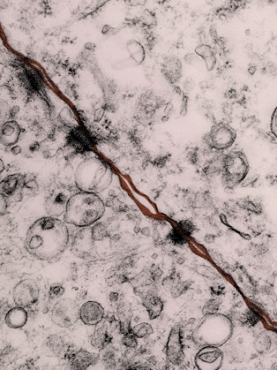
The Role of Membranes
Membranes fulfill a role in recognition and communication between cells.
  This allows ‘like’ cells to form tissues and organs.
  It allows the body to distinguish foreign material from its own tissue.
Some membranes are involved in membrane transport, where:
  materials required by the cell are imported into the cell.
  waste products are removed from the cell.
The plasma membrane surrounds the cell and has an important role in containment, transport, signaling and communication. The image above shows the plasma membranes of two neighboring cells.

Slide 10
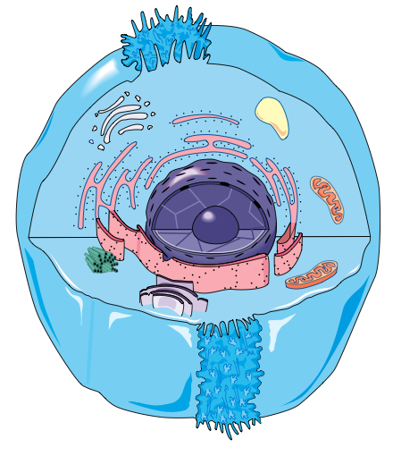
Membrane Bound Organelles
Nucleus
Membranes are also found within eukaryotic cells as part of the structure of membranous organelles.
Examples of membrane-bound organelles include:
  mitochondria
  nucleus
  Golgi apparatus
  endoplasmic reticulum
  vesicles
  vacuoles
  chloroplasts (not shown, this example is of an animal cell)
Golgi
Vacuole
Vesicle
Mitochondria
Smooth
endoplasmic reticulum
Rough
endoplasmic reticulum

Slide 11
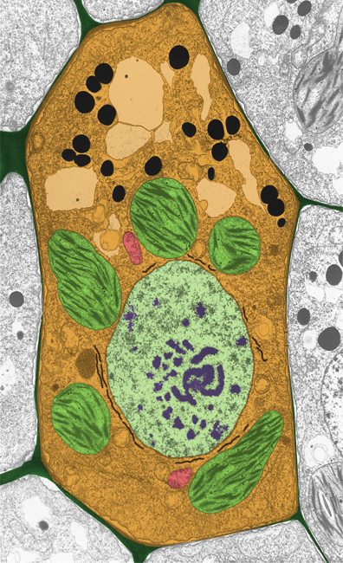
Membranes Inside Cells
The membranes of organelles have the same basic structure as the plasma membrane surrounding the cell.
Membrane-bound organelles compartmentalize specific activities within the cell.
Examples of membrane-bound organelles are shown on the false-color TEM of a plant cell (right):
  A: vacuole
  B: mitochondrion
  C: nucleus
  D: chloroplast
A
B
C
D
Photo: Brian Finerran

Slide 12
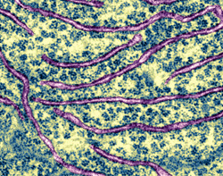
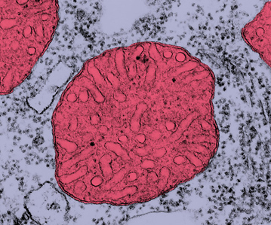
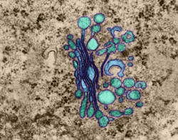

The Functions of Organelles
Nucleus of a lymphocyte
Nucleus
All cellular organelles have specific functions.
The cell can be compared to a factory
with an assembly line.
  Organelles in the cell provide the equivalent of the:
    control center (nucleus)
    packaging department (Golgi)
    transport system (endomembrane
    systems and vesicles)
    power supply (mitochondria)
    assembly line (ribosomes)
    repair and maintenance (lysosomes)
Rough endoplasmic reticulum
Mitochondrion
Golgi apparatus

Slide 13
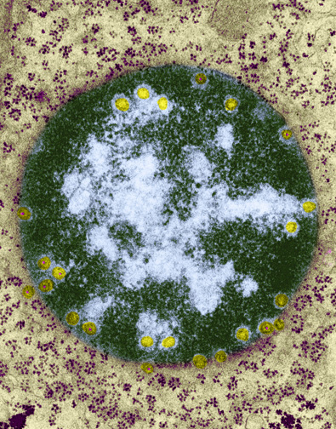
The Control Center
In eukaryotic cells, the nuclear membrane, or nuclear envelope, encloses the nucleus, separating its contents from the cytoplasm.
The nuclear envelope controls the passage of genetic information to the cytoplasm and may also protect the DNA.
  It is a double membrane.
  The two membranes are separated by
  a space of 20-40 nm.
  A layer of protein associated with the nuclear side of the envelop helps to maintain the shape of the nucleus.
  The nuclear envelope is perforated by nuclear pores about 100 nm in diameter. The pores regulate the passage of materials into and out of the nucleus.
Nuclear envelope
The nuclear envelope is a double layered structure perforated by pores.

Slide 14
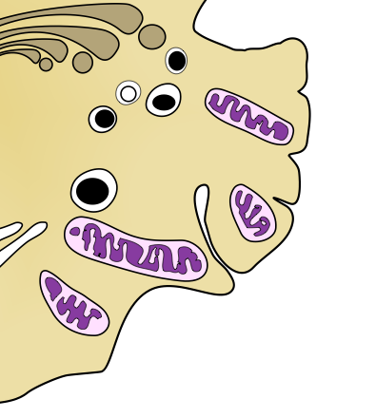
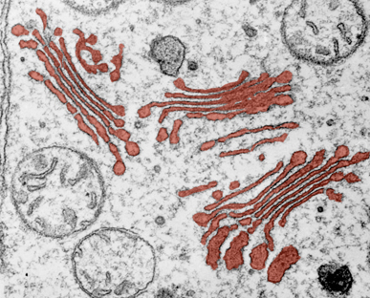
Packaging and Secretion
In eukaryotic cells, the center of manufacturing, storing, sorting and shipping is the Golgi apparatus (right).
  Within the Golgi, the products of the endoplasmic reticulum, e.g. lipids
  and proteins, are modified, stored,
  and sent to other cellular destinations.
  The Golgi apparatus is also the site
  of lysosome formation.
  Substances leave the Golgi packaged
  into membrane-bound vesicles.
  The Golgi is most extensive in cells that
  are specialized for secretion (e.g. antibody secreting cells).
Secretory vesicle

Slide 15
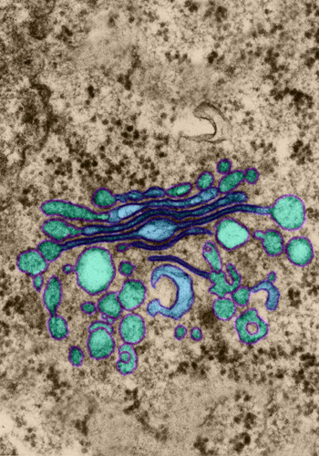
Packaging and Secretion
A Golgi stack has two distinct faces:
  the cis face (or forming face) receives vesicles from the ER.
  the trans face (or maturing face) ships materials in vesicles, which pinch off from
  the Golgi and travel to other sites.
Products of the ER are usually modified as they move from the cis to the trans face.
  Products are modified in stages; different cisternae between cis and trans faces contain different suites of enzymes.
  Vesicles transfer the products of processing between one cisterna and the next.
  Before products are shipped, they are tagged with (e.g. with phosphate groups) for transport to different parts of the cell.
cis face
Secretory vesicle
trans face
The Golgi apparatus comprises stacks of membrane-bound sacs called cisternae.

Slide 16
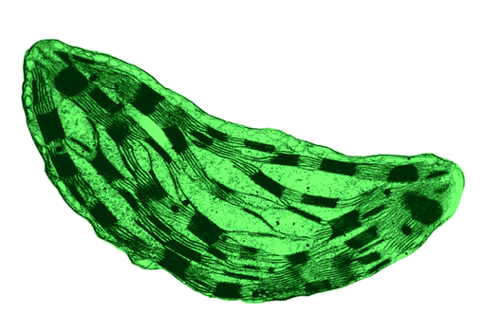
Light Capture and Carbon Fixation
Chloroplasts are membrane-bound organelles found in plants and protists. They are the site of photosynthesis.
The chloroplast is enclosed by an envelope consisting of two membranes separated by a very narrow intermembrane space.
Membranes also divide the interior of the chloroplast into compartments:
  flattened sacs called thylakoids stacked into structures called grana.
  the stroma (fluid) outside the thylakoids.
The light reactions of photosynthesis occur on the thylakoid membranes. The dark reactions occur in the stroma.
Grana
Stroma
Chloroplasts have a double membrane called the chloroplast envelope. The outer membrane is permeable to metabolites, and the inner membrane contains many transport proteins.

Slide 17
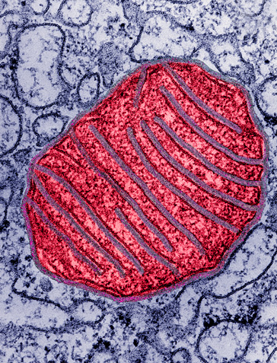
Energy Production
Mitochondria, like chloroplasts, are membrane-bound organelles that convert energy to forms the cell can use.
The mitochondrion is the site of cellular respiration, in which ATP is generated from the oxidation of fuels such as glucose.
They are found in almost all eukaryotic cells.
Like chloroplasts, mitochondria are enclosed by an envelope of two membranes separated by a narrow intermembrane space.
    the outer membrane is smooth.
    the inner membrane is convoluted, with infoldings called cristae.
    the membranes divide the mitochondrion into two internal compartments.
IM
OM
Mitochondria have a double membrane structure. The outer membrane (OM) controls the passage of materials involved in aerobic respiration. Inner membranes (IM) provide the attachment sites for the enzymes involved in cellular respiration.

Slide 18
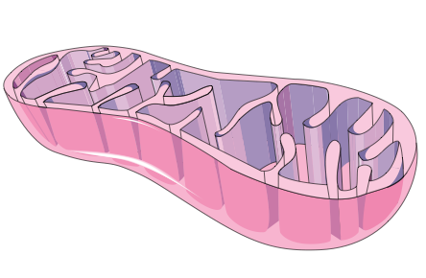

Compartmentation
Membrane systems form discrete regions within the cells where enzyme reactions are compartmentalized.
    Specific enzymes are often located in particular organelles, and even within particular regions of the organelle.
The rate at which a reaction proceeds
is limited by the speed at which substrates can enter the organelle.
Membranes regulate this passage, just as they regulate movement of materials into and out of the cell itself.
For example, the rate of ATP production is limited by the rate at which ADP can enter the mitochondrion.
A mitochondrion
Inner membrane
Outer membrane
Mitochondrion (false colored) taken by TEM.
Magnification x 14,000

Slide 19
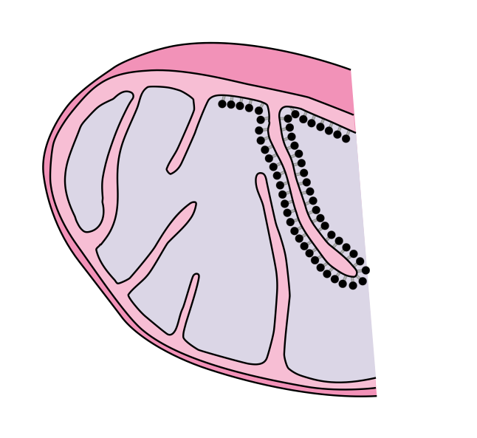
Enzymes in Organelles
Amine oxidases and other enzymes on the outer membrane surface.
Adenylate kinase and other phosphorylases between the membranes.
Respiratory assembly enzymes embedded in the membrane (ATPase).
Many soluble enzymes of the Krebs cycle, as well as the enzymes for fatty acid degradation, float in the matrix.
The mitochondrion (cross section above) is an excellent example of how membranes can compartmentalize reactions in cellular organelles. Many different enzyme reactions occur in specific regions of the mitochondrion.

Slide 20
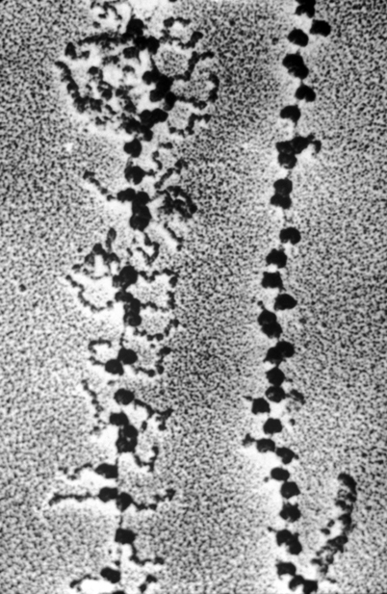
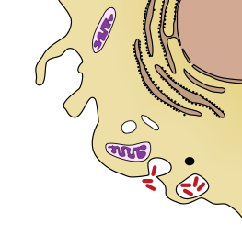
Protein Synthesis
Protein synthesis occurs on ribosomes, which can be:
  bound to the rough endoplasmic reticulum (RER) or
  free in the cytosol
Most protein synthesis occurs at the RER. These proteins are usually exported from the cell or incorporated into membranes.
Protein modification can also occur within the ER.
Proteins produced on free
ribosomes stay in the cytosol.
Polypeptide chain
Ribosomes

Slide 21
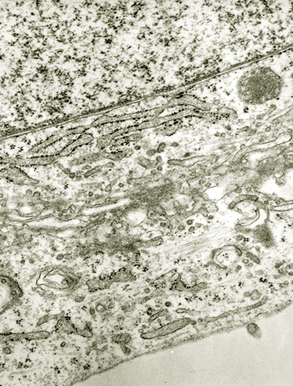
The Endomembrane System
Many of the different membranes within the
cell are part of the endomembrane system.
These membranes are related by:
  direct physical continuity
  by the transfer of membrane segments
  through the movement of vesicles.
Although related, the various membranes
are structurally and functionally distinct.
The endomembrane system includes:
  nuclear envelope
  endoplasmic reticulum
  Golgi and vesicles
  lysosomes, peroxisomes, vacuoles
It does not include mitochondria or chloroplasts.
NE
ER
V
The nuclear envelope (NE) is part of the endo-membrane system, which includes vesicles (V) and endoplasmic reticulum (ER)

Slide 22
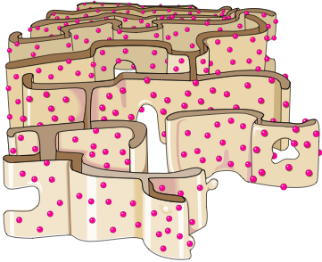
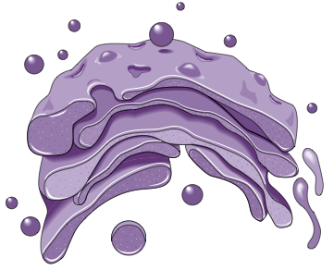
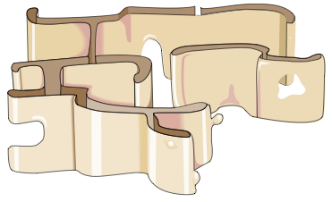
Macromolecule Synthesis
The endomembrane system is important in the synthesis of macromolecules.
Cells produce a range of macromolecules; organic polymers made up of repeating units of smaller molecules.
  The synthesis, packaging and movement of these molecules inside the cell involves a number of membrane bound organelles
  (right and below).
Rough endoplasmic
reticulum (RER)
(ribosomes attached)
Golgi
Smooth endoplasmic reticulum (SER)

Slide 23
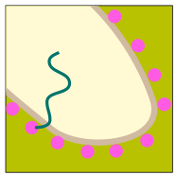
Macromolecule Synthesis
Creating Proteins for
Exocytotic Secretion
A polypeptide chain grows from a bound ribosome.
The chain is threaded through the ER membrane into the cisternal space, possibly through a pore.
As it enters the cisternal space inside the ER, it folds up into a 3-dimensional shape.
Most proteins destined for secretion are glycoproteins. The carbohydrate is attached to the protein by enzymes.
The ER membrane keeps secretory proteins separate from proteins made by free ribosomes.
Proteins destined for secretion leave the ER in transport vesicles which bud off from the ER. The chain is threaded through the ER membrane into the cisternal space, possibly through a pore.
These vesicles are received by the Golgi apparatus, where they are modified, stored and eventually shipped to the cell's surface, for exportation by exocytosis.
Transfer vesicle from the ER

Slide 24
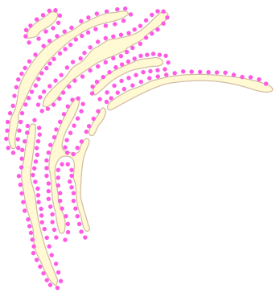
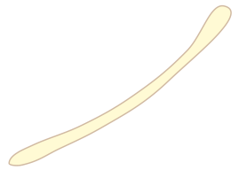

Macromolecule Synthesis
Smooth endoplasmic reticulum
Enzymes of the smooth ER are important to the synthesis of fats, phospholipids and steroid hormones.
Rough endoplasmic reticulum
Proteins destined for secretion are assembled by ribosomes attached to the rough ER.
The Golgi apparatus receives transport vesicles from the ER
Cisternal space
Transport vesicles
Membrane of rough ER
The Golgi apparatus produces vesicles that are transported to other parts of the cell or exported from the cell.
Ribosome
Growing polypeptide chain

Slide 25
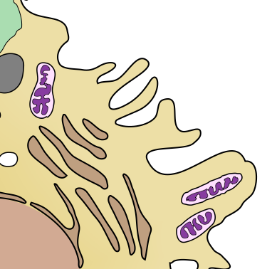
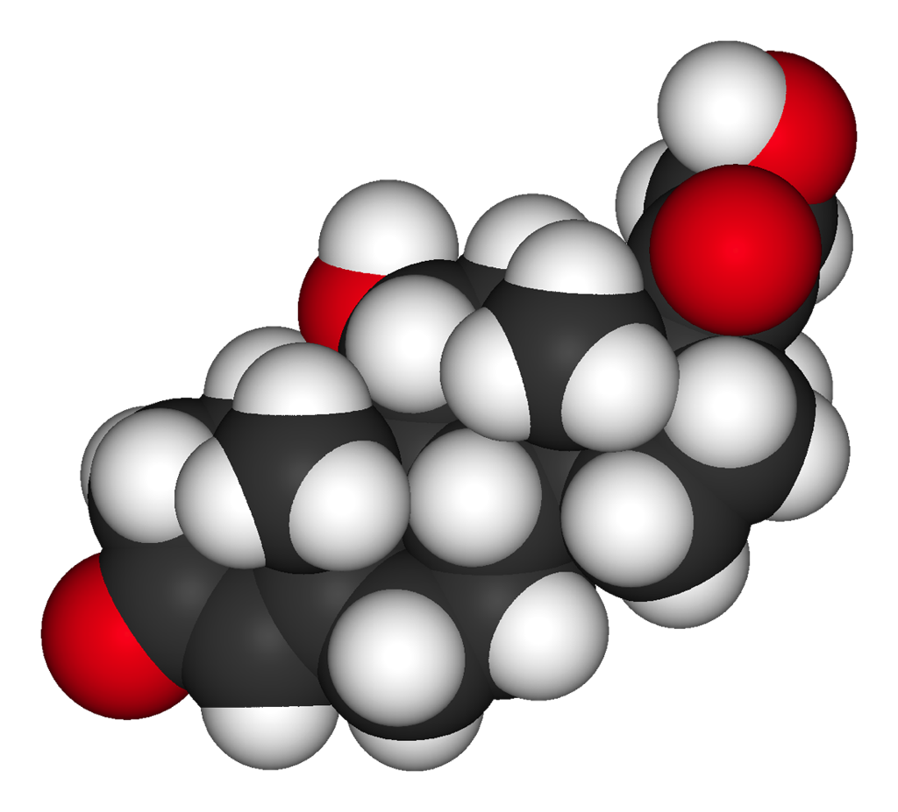

Lipid Synthesis
The smooth endoplasmic reticulum is the site of lipid synthesis in the cell.
  The smooth ER produces fats, phospholipids and steroids.
Unlike rough ER, smooth ER lacks ribosomes (hence its name).
Important synthesis products include:
  Sex hormones (e.g. testosterone and estrogen).
    Smooth ER is abundant in cells that secrete these products (testes and ovaries).
  Steroid hormones (e.g. cortisol) produced by the adrenal glands.
    Cortisol plays an important role in regulating blood pressure and cardiovascular activity.
A 3D space filling model of the steroid hormone cortisol.

Slide 26
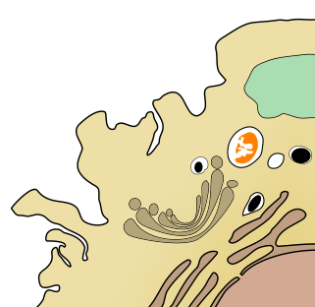
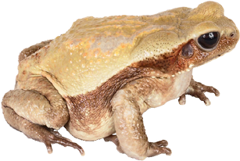
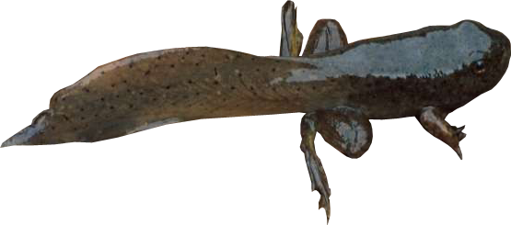
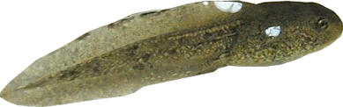
Autolysis
Lysosomes are specialized organelles containing hydrolytic enzymes enclosed within a single membrane. They are responsible for:
  intracellular digestion of macromolecules
  recycling of cellular components (autophagy)
  autolysis, the enzymatic self digestion of the cell itself
Autolysis is usually prevented because the enzymes are enclosed within the lysosome membrane.
Autolysis is important in the development of some organisms. During metamorphosis in frogs,
lysosomes destroy the cells of the froglet tail
resulting in a tail-less adult.
Frog
(autolysis complete)
Tadpole
Froglet
(undergoing autolysis)

Slide 27
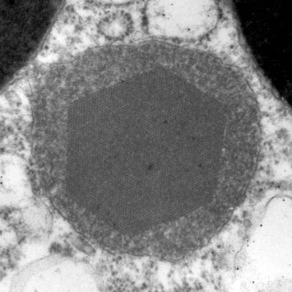
Oxidative Reactions
Peroxisomes are specialized lysosomes which rid the body of toxic substances by a series of oxidative reactions.
They are usually roughly spherical and often have a granular or crystalline core.
Peroxisomes contain oxidative enzymes which break down toxic organic molecules (e.g. alcohol detoxification).
  Hydrogen ions from the toxic component are transferred to oxygen atoms forming hydrogen peroxide (H2O2).
  Hydrogen peroxide is toxic, but within
  the peroxisome it is converted by the enzyme catalase into harmless water
  and oxygen molecules.
Photo: Alexandre Lobo da Cunha, University of Porto
TEM of a peroxisome from the marine snail Gibulla umbilicalis. Note the crystalline appearance of the core. This is where the enzymes are thought to be concentrated.

Slide 28

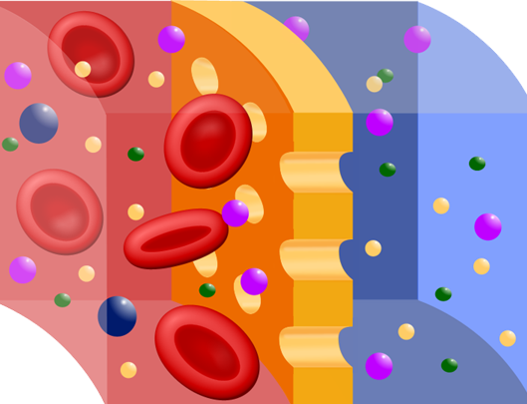

Cell Transport
Substances need to move into and out of the cell. They are moved across the plasma membrane by cellular transport mechanisms. These may be:
  passive (not requiring energy)
    diffusion and facilitated diffusion
    osmosis
  active or energy requiring
    ion pumps
    cytosis
The plasma membrane is partially
permeable to certain molecules.
  Channel and carrier proteins are
  involved in selective transport of small
  molecules and ions across the membrane.
  Large molecules (e.g. proteins) are
  transported by cytosis (formation of
  membrane-bound vesicles or vacuoles).
Plasma membrane
Cell cytoplasm
The plasma membrane is partially permeable, allowing some molecules to pass through, and preventing the passage of others.

Slide 29

Diffusion
Diffusion is a passive transport process. It does not require energy to occur.
Diffusion describes the movement of molecules from regions of high concentration to areas of low concentration along a concentration gradient.
In biological systems, diffusion often occurs across partially
permeable membranes.
High concentration
Low concentration

Slide 30
Diffusion Across Membranes
In any type of diffusion, each type of diffusing molecule (gas, solvent, solute) moves along its own concentration gradient.
An equilibrium is reached when the net concentration of molecules on each side of the membrane are equal.
  At this point, net movement stops.
Two-way diffusion across a partially permeable membrane is common in biological systems.
  For example, at the lung surface, carbon dioxide diffuses out of the blood across the membranes of the capillaries and the lung alveoli, while oxygen diffuses in the opposite direction into the blood.
Partially permeable membrane

Slide 31
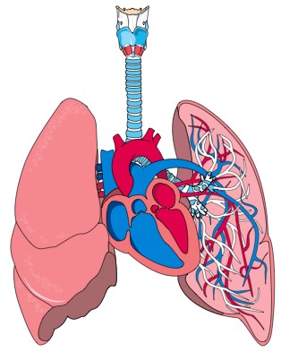
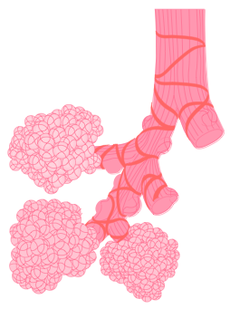
Factors Affecting Diffusion
Four main factors affect the rate of diffusion across a membrane:
  Concentration gradient. Diffusion rates will be higher when there is a greater difference in concentration between two regions.
  The diffusion distance. Diffusion over shorter distances occurs at a greater rate than diffusion over
  larger distances.
  Surface area. The rate of diffusion is greater when there is a large surface area across which diffusion can occur.
  Physical barriers. Thick barriers
  slow the rate of diffusion. Pores in a barrier enhance diffusion.
Human lung
The gas exchange systems of air breathing vertebrates rely on the rapid two-way diffusion of gases across the thin membranes of the lung alveoli.
Air sacs (alveoli)

Slide 32
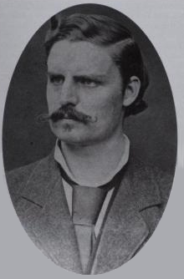
Fick’s Law
The factors governing the rate of diffusion across membranes are described by Fick’s law.
Fick’s law is expressed as:
Difference in concentration across the membrane
Surface area
of membrane
X
Length of the diffusion path (thickness of the membrane)
Adolf Fick (above) was a German physiologist who proposed the laws that govern gas diffusion across a membrane (Fick’s law). He is also credited with designing the first contact lens and devising the technique for measuring cardiac output (Fick’s principle).

Slide 33
Facilitated Diffusion
Facilitated diffusion occurs when a substance is aided across a membrane by ionophores.
  Ionophores are lipid-soluble molecules that increase the permeability of cellular membranes to specific ions.
  Ionophores often act as channel formers that introduce a hydrophilic pore in the membrane through which ions may pass.
Facilitated diffusion selectively increases the diffusion rate of specific molecules (e.g. glucose, amino acids).
  It does not require energy because the molecules are not moving against their concentration gradient.
  It occurs when a higher diffusion rate is desirable, e.g. transport of glucose into skeletal muscle fibers.
Ionophore
Partially permeable membrane

Slide 34
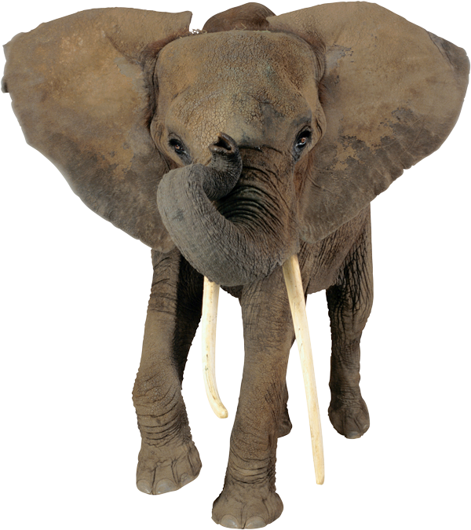
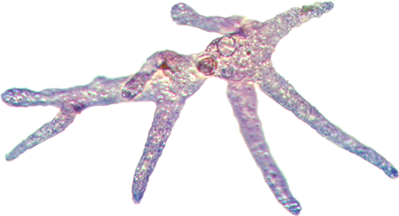
Limitations to Cell Size
A small organism (such as a unicellular protist) has a large surface area relative to its volume. For these organisms, diffusion is an effective way to transport materials into and out of the cell.
As an organism becomes larger, its surface area decreases relative to its volume and diffusion ceases to be an effective way to exchange materials with the environment.
For this reason, there is a physical limit for the size of a cell, with the effectiveness of diffusion being the controlling factor.
Small surface area relative to volume
For small organisms such as the Amoeba (left), diffusion across the body surface is a viable method of exchanging materials (e.g. gases) with the environment. For large organisms, such as an elephant (above), specialized systems, such as lungs, permit efficient exchanges with the environment.
Large surface area relative to volume

Slide 35
Limitations to Cell Size
The plasma membrane functions as a selective barrier that regulates the cell’s chemical composition.
Oxygen
Food
Carbon dioxide
Wastes
The small size of single-celled protists such as Amoeba (above), provides a large surface area relative to the cell’s volume.
This is adequate for materials to be moved directly into and out of the cell by diffusion or active transport across the plasma membrane.

Slide 36
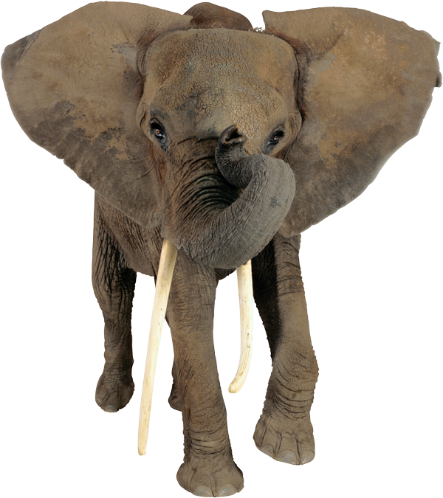
Limitations to Cell Size
The surface area of an elephant is increased, for radiating body heat, by large flat ears.
Specialized exchange surfaces (e.g. lungs, capillary beds, gut villi, and skin) provide a high surface area across which exchanges with the environment can be made. Complex organ systems link exchange surfaces to move materials efficiently through the body between these exchange surfaces.
Multicellular organisms
To overcome the problems of small cell size, plants and animals became multicellular. They have a small surface area compared to their volume but have evolved various adaptive features to increase their effective surface area.
Respiratory gases cannot reach body tissues by diffusion across the body surface alone.

Slide 37
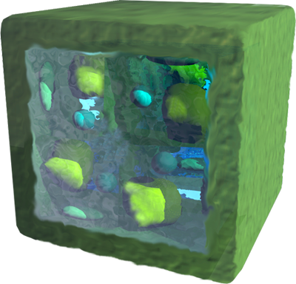
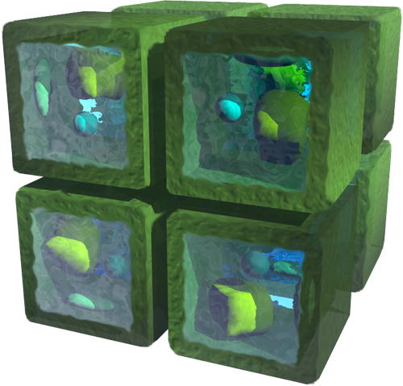
Limitations to Cell Size
The eight small cells (below right) and the single large cell (above right) have the same total volume, but their surface areas are different.
The small cells together have twice the total surface area of the large cell, because there are more exposed (inner) surfaces.
Real organisms have complex shapes, but the same principles apply. The surface-area volume relationship has important implications for processes involving transport into and out of cells across membranes.

Slide 38
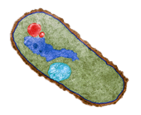
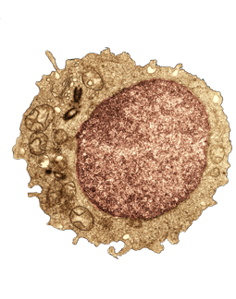
Limitations to Cell Size
As cell size increases:
  its volume increases at a faster rate than the surface area.
  there is less surface area, so the surface area
  to volume ratio decreases (see table below).
  large cells will have difficulties in exchanging materials at rates adequate to meet demands. Cell size is limited by diffusion capability.
Cube size | Surface area | Volume (h x w x d) | Surface area to volume ratio
2 cm cube | 2 x 2 x 6 = 24 cm² | 2 x 2 x 2 = 8 cm² | 24 to 8 = 3:1
3 cm cube | 3 x 3 x 6 = 54 cm² | 3 x 3 x 3 = 27 cm² | 54 to 27 = 2:1
4 cm cube | 4 x 4 x 6 = 96 cm² | 4 x 4 x 4 =64 cm² | 96 to 64 = 1.5:1
5 cm cube | 5 x 5 x 6 = 150 cm² | 5 x 5 x 5 = 125 cm² | 150 to 125 = 1.2:1

Slide 39
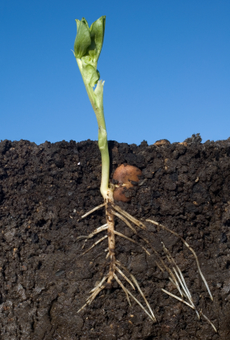
Osmosis
Osmosis is defined as the net movement of water molecules across a partially permeable membrane from a region of higher to lower concentration (of water molecules).
Usually, water movements are expressed in terms of water and solute potential:
  Water molecules always move towards regions of more negative water potential (=higher concentration of solute molecules).
Osmosis provides the primary means by which water is transported into and out of cells. The net direction of water movement in cells can be predicted on the basis of the water potential of the solutions involved.
Osmosis is affected by the same factors
as diffusion.
A plant’s root system covers a large area, allowing it to draw water and nutrients up from the soil. Water is drawn into the root system by osmosis.

Slide 40

What is Water Potential?
The water potential (Ψ) of a solution describes the tendency for water molecules to enter or leave a solution by osmosis.
  Pure water has the highest Ψ, set at zero.
  Dissolving any solute into pure water lowers the water potential (makes it more negative).
  Water always diffuses from regions of less negative to more negative water potential.
Water potential is determined by two components:
  the solute potential, Ψs (of the cell sap)
  the pressure potential, Ψp.
  This is expressed as a simple equation:
Dialysis tubing is a partially permeable cellulose or cellophane tubing used to demonstrate osmosis. The tubing (filled with a solution) simulates a plasma membrane. By placing it into containers of varying osmotic solutions, the principles of osmosis can be explored.
ΨCell = Ψs + Ψp

Slide 41

Osmosis & Water Potential
Less negative ψs
Less negative ψ
Hypotonic
More negative ψs
More negative ψ
Hypertonic
Loses water by osmosis
Gains water by osmosis
Water molecules
Solute molecules cannot pass through the partially permeable membrane
Partially permeable membrane
Pressure potential (ψp)
Solute potential (ψs)
The hydrostatic pressure to which water is subjected (e.g. by a rigid plant cell wall). It is usually positive. It is sometimes called turgor or wall pressure.
ψs measures the reduction in water potential due to the presence of solutes. It is negative. It is sometimes referred to as the osmotic potential or osmotic pressure.
There is a net movement of water molecules towards the more negative ψ until water concentrations equalize.

Slide 42


Turgor in Plant Cells
If a plant cell is placed in a hypotonic solution, water enters the cell causing it to swell. The rigid cell wall prevents cell rupture.
The cell contents press against the cell wall creating a wall pressure
(Ψp) which rises progressively until it offsets Ψs. Water uptake stops when the Ψcell = 0.
Cells in this state are termed turgid.
Pure water (hypotonic)
ψ = 0
ψs = -400 kPa
ψp = 200 kPa
Pressure is placed on the cell wall which bulges outward.
Water enters the cell
Healthy turgor in Coleus

Slide 43


Plasmoylsis in Plant Cells
If a plant cell is placed in a hypertonic solution, the plant cell loses water to the environment.
The membrane shrinks away from the cell wall, the vacuole collapses, and the cell becomes flaccid (Ψp = 0).
This state is called plasmolysis.
Full plasmolysis is irreversible;
the cell cannot recover by
taking up water.
Hypertonic salt solution ψ = –600
ψs = -400 kPa
ψp = 0 kPa
Water
Wilting in Coleus induced by water loss from the cells.
Plasma membrane shrinks
Cytoplasm

Slide 44

Cellular Environments
Animal cells lack the cell wall that, in plants, contributes to pressure potential (Ψp).
Without a rigid cell wall, animals cells may change shape depending upon the conditions of the cellular environment.
Biologists often refer to these conditions as:
  Isotonic
  Hypotonic
  Hypertonic
When the extracellular environment has the same water potential (osmotic environment) as a cell, it is referred to as isotonic.
Under these conditions, an animal cell maintains its normal shape and form.
In an isotonic environment, cells, such as the red blood cell above, maintain their normal shape as there is no net water movement across the plasma membrane.

Slide 45

Hypotonic Environment
When the water potential of the extracellular environment is less negative (lower solute concentration) than that of the cell, it is termed hypotonic.
In a hypotonic environment, water will enter the cell because the cell cytoplasm has a higher solute concentration.
In an animal cell (with no cell wall), this will eventually cause cell lysis (the cell will burst open).
In cells surrounded by a cell wall (e.g. plant cells), the cell wall provides rigidity and a wall pressure to counteract the influx of water and prevent cell rupture.
In a hypotonic environment, cells swell because of a net gain of water across the plasma membrane. This red blood cell will eventually burst because its membrane cannot withstand the internal pressure.

Slide 46

Hypertonic Environment
When the water potential of the extracellular environment is more negative (higher solute concentration) than that of the cell,
it is termed hypertonic.
In a hypertonic environment, the cell will lose water because the cellular environment has a higher solute concentration.
    The term for this process in animal cells is crenation (alt. crenulation).
    In plant cells, the process is
    termed plasmolysis.
    A cell can lose its ability to function if it becomes too severely dehydrated.
In a hypertonic environment, cells shrink because of a net loss of water across the plasma membrane. This red blood cell has lost its normal shape and form and is termed crenate.

Slide 47

Active Transport Processes
Active transport processes require energy expenditure because materials must be moved against their concentration gradient.
Active transport is performed by specific carrier proteins in the membrane.
Transport proteins harness the energy of ATP to pump molecules from a low concentration to a high concentration (the reverse of diffusion).
  When ATP transfers a phosphate group to the carrier protein, the protein changes its shape so that the bound molecule can move across the membrane.
Space filling model of rabbit
calcium ATPase. Calcium ATPase is a membrane transport protein which transfers calcium after a muscle has contracted.

Slide 48


Sodium-Potassium Pumps
Extracellular fluid
Na⁺
Na⁺
K⁺
The sodium-potassium pump is a protein in the membrane that exchanges sodium ions (Na⁺) for potassium ions (K⁺) across the membrane.
ATP is used as the energy source for the exchange.
The unequal balance of
Na⁺ and K⁺ across the membrane creates large gradients in ion concentration, which can be used to drive other active transport mechanisms.
Na⁺
Plasma membrane
Carrier protein
K⁺
ATP
Na⁺
Na⁺ moves to its binding site
K⁺
Cell cytoplasm

Slide 49

Proton
Pumps
Extracellular fluid
Proton pumps use the energy from ATP to move hydrogen ions (H⁺) from inside the cell to the outside.
This creates a large difference in the proton concentration either side of the membrane, leaving the inside of the plasma membrane negatively charged.
The potential difference created can be coupled to transport other molecules across the membrane.
H⁺
H⁺
H⁺
H⁺
H⁺
H⁺
Carrier protein
Plasma membrane
ATP
H⁺
Cell cytoplasm

Slide 50

Coupled Transport
Extracellular fluid
Diffusion of hydrogen ions down their concentration gradient
Coupled transport is also
called co-transport.
  Plant cells use the hydrogen gradient created by proton pumps to actively transport nutrients into the cell.
  For example, the return of
  H⁺ is coupled to the transport of sucrose into the phloem cells. The sucrose rides with the H⁺ as it diffuses down the concentration gradient maintained by the proton pump.
H⁺
H⁺
H⁺
Sucrose
Carrier protein
H⁺
Plasma membrane
H⁺
Cell cytoplasm

Slide 51
Summary-Membrane Pumps
Membrane pumps are proteins,which require energy (often as ATP) to transport molecules across the cell membrane.
The activity of pumps may be coupled, e.g. the accumulation of H⁺ from the proton pump is used to drive the transport of sucrose against its concentration gradient.
Extracellular fluid
Na⁺
Na⁺
H⁺
H⁺
Na⁺
K⁺
H⁺
H⁺
H⁺
Plasma membrane
H⁺
ATP
K⁺
ATP
Na⁺
K⁺
H⁺
H⁺
Cell cytoplasm

Slide 52

Active Transport: Cytosis
Cytosis is a form of active transport involving the formation of membrane-bound vesicles or vacuoles.
Regions of the plasma membrane become infolded (invagination) or outfolded (evaginated) to transport substances across the membrane.
Cells are able to do this because of the mobile nature of the membrane.
Most cells carry out various forms of cytosis, including:
  endocytosis
  exocytotosis
Membrane-bound vesicle
Plasma membrane folding inwards
This cell is carrying out a form of endocytosis called pinocytosis in which the plasma membrane forms invaginations to enclose liquids and bring them into the cell.

Slide 53


Endocytosis
Endocytosis describes the incorporation of substances from outside the cell into the cell as a membrane-bound vesicle or vacuole.
During endocytosis the plasma membrane invaginates (folds in) around the molecules to be transported into the cell.
There are three forms of endocytosis:
  phagocytosis: the engulfment
  of solid particles.
  pinocytosis: the engulfment
  of liquid particles.
  receptor mediated: engulfment of
  specific particles according to membrane receptors.
Phagocytosis
Solid particle
CDC
Pinocytosis
Membrane-bound vesicle

Slide 54

Endocytosis
1
Materials that are to be collected and brought into the cell are engulfed by an invagination of the plasma membrane.
Plasma membrane
2
Vesicle buds off from the plasma membrane.
3
The vesicle carries molecules into the cell. The contents may then be digested by enzymes delivered to the vacuole by lysosomes.
Cell cytoplasm

Slide 55


Endocytosis: Phagocytosis
Phagocytosis (literally cell eating) describes the engulfment and transport of solid particles into the cell.
  The particles are contained within a membrane enclosed sac (a vacuole).
  Digestion of the particles occur when the vacuole fuses with a lysosome containing digestive enzymes.
Amoebae use phagocytosis to capture and ingest their food (top right).
In humans, white blood cells, such as neutrophils and macrophages, use phagocytosis to clean up cell debris and foreign material such as bacteria.
  The macrophage (right) has engulfed a Staphylococcus bacterium.
Food particle
Amoeba pseudopod
Engulfed bacterium

Slide 56
Endocytosis: Pinocytosis
Pinocytosis describes the engulfment of liquids or fine liquid suspensions into the cell.
  Invaginations of the plasma membrane enclose the liquid droplets within small vesicles.
  The fluid within the vesicle is transferred to the cytosol.
Pinocytosis is a non-specific form of endocytosis.
  Whatever solutes are suspended within the watery medium are also taken into the cell.
Plasma membrane engulfing liquid substance.
Membrane-bound vesicle
Pinocytosis by a capillary endothelial cell. TEM (X12,880)

Slide 57

Receptor-Mediated Endocytosis
Unlike the other forms of endocytosis, receptor mediated endocytosis involves the engulfment and transport of specific molecules into the cell.
The cell membrane has regions of receptor proteins exposed to the extracellular environment.
The receptor proteins occur in clusters (called coated pits) and have binding sites that will only bind specific molecules.
Extracellular fluid
Receptor protein
Plasma membrane
Cytoplasm

Slide 58


Receptor-Mediated Endocytosis
The cytoplasmic side of the coated pit is lined with a special protein called clathrin protein, which provides membrane stability (right).
Target molecule
Clathrin protein
Coated vesicle
When the target molecule (ligand) binds to the receptor protein (left), a coated vesicle forms around it, allowing the molecule to be imported into the cell.

Slide 59

Exocytosis
Exocytosis releases substances from the inside of the cell to outside of the cell.
Exocytosis occurs by fusion of a vesicle membrane with the plasma membrane. The vesicle contents are then released to the outside of the cell.
In multicellular organisms, various types of cells are specialized to manufacture and export products from the cell to elsewhere in the body or outside it.
Transport vesicle
Cross section through the plasma membrane of cardiac muscle showing the presence of transport vesicles. TEM X 162,000

Slide 60

Exocytosis
3
The contents of the vesicle are expelled into the intercellular space (which may be into the bloodstream).
2
Vesicle fuses with the plasma membrane.
1
Vesicle carrying molecules for export moves to the perimeter of the cell.

Slide 61

Cell Communication and Recognition
Cells have a means of communication
and recognition which allows them to:
  form tissues with cells of the same or
  a related type.
  detect foreign cells and launch an
  immune response.
Special signaling proteins in the
plasma membrane act as:
  receptor molecules for hormones
  and neurotransmitters
  identity markers
Signaling proteins are often glycoproteins.
Direction of impulse
Synaptic vesicle
Post-synaptic cell
Cell communication occurs across synapses. Electrical impulses result in neurotransmitter transfer between cells. The neurotransmitter produces a response in the post-synaptic cell.

Slide 62


Cell Signaling
Cells use signaling molecules (chemical messengers) to:
  gather information about the environment
  respond to changes in their environment
  communicate with other cells
The signaling and response process is called the signal transduction pathway.
  It often involves a number of enzymes and molecules in a signal cascade that results in a large response in the target cell.
Caffeine is a metabolic stimulant.
It is represented here as a 3D stick model.
The caffeine contained in this cup of coffee acts as a chemical signal, stimulating the central nervous system. It will temporarily reduce physical fatigue and increase mental alertness in the user.

Slide 63


Types of Cell Signaling
Blood vessel
Hormone
There are three main pathways by which cell signaling occurs:
  the endocrine pathway
  the paracrine pathway
  the autocrine pathway
Cell signaling pathways are categorized primarily on the distance over which the signal molecule is transmitted.
  In the endocrine pathway (top right), the signals are hormones, released by endocrine glands. They travel via the circulatory system to target cells and tissues.
  The autocrine pathway involves a cell producing, and reacting to, its own signal. This pathway is seen in the T cell response to infection (below right).
Target cell
Endocrine signaling involved hormones carried in the blood, e.g. sex hormones, growth factors and neurohormones such as dopamine.
Signal molecule
In vertebrates, T cells produce a growth factor when they encounter a foreign antibody. They respond to the growth factor by proliferating.

Slide 64


Paracrine Signaling
In the paracrine pathway, a signal released from a cell acts on target cells within its immediate vicinity.
  The production and transmission of neurotransmitters, which are used to transfer signals between a cell and a neuron, is an example of a common paracrine signaling pathway.
Direct cell to cell signaling is a form of paracrine signaling:
  The chemical message is transferred directly between neighboring cells. This form of signal transduction is important during embryonic development.
Signal molecule
In paracrine signaling, a signal released from a cell and acts upon target cells within its immediate vicinity.
Signal molecule
Direct cell to cell signaling involves a signal molecule being transferred directly between neighboring cells.

Slide 65



Types of Cell Signaling Molecules
Cell signals (ligands) are a varied group of chemical messengers. They fall into six broad groups:
  Steroid hormones (e.g. progesterone).
  Simple gases (e.g. nitric oxide).
  Neurotransmitters (e.g. adrenalin).
  Peptide hormones and growth factors (e.g. insulin).
  Eicosanoids, a class of lipids (e.g. prostaglandins).
  Plant hormones (e.g. auxins).
Progesterone
Insulin like growth factor 1
Nitric oxide

Slide 66
Types of Signal Receptors
Extracellular domain
Outside of cell
The binding sites of cell receptors are very specific; they will only bind certain signal molecules (ligands).
This prevents them from reacting to every signal encountered by the cell.
Cell receptors fall into two major categories:
  Transmembrane receptors: these span the cell membrane and bind the ligands that cannot cross the plasma membrane, and include:
      ion channels.
      protein kinases.
      G-protein linked receptors.
  Cytoplasmic receptors: these are located within the cell cytoplasm. They bind the ligands that can cross the plasma membrane.
Intracellular domain
Cell cytosol
Transmembrane receptors (above) have an extracellular domain located outside the cell, and an intracellular domain within the cell cytosol.

Slide 67


Generalized Signal Process
Ligand
Outside of cell
1
The signal (or ligand) binds to a specific receptor protein. This prevents them from reacting to every signal encountered by the cell. In this example, the receptor protein is on the cell surface, but some receptors are located within the cell cytosol.
The binding of the ligand to the receptor causes a message to be conveyed to the inside of the cell, either directly from the receptor molecule (as here), or indirectly (via a cascade of signaling responses which amplify the signal.
The cellular activity changes in response to the signal (e.g. gene activation or alteration of metabolic activity). In this example, the signal molecule binds to DNA to activate a gene.
Receptor protein
Cell cytosol
2
Signal molecule
3
DNA
New protein expressed

Slide 68
Insulin Signaling Pathway
Insulin is a peptide hormone secreted by the pancreas. Its primary role is maintaining the homeostasis of blood glucose levels.
Insulin production is tightly regulated because and over-or underproduction has serious physiological consequences and may even result in death:
  too little results in elevated blood glucose levels (hyperglycemia).
  too much results in low blood glucose levels (hypoglycemia).
The insulin receptors (right) are surface bound protein kinase receptors. They facilitate a cellular response by catalyzing the transfer of a phosphate group from ATP to a target protein.
  Insulin receptors are made up of four subunits: 2 α-subunits and 2 β-subunits.
Outside of cell
α-subunits
β-subunits
Extracellular domain
Intracellular domain
Cell cytosol

Slide 69
Insulin Signaling Pathway
Two molecules of insulin must bind to the extracellular domain of the insulin receptor to activate it.
Once the insulin is bound, the receptor changes shape to expose and activate a protein kinase intracellular domain.
Unbound insulin
Bound insulin
Phosphate groups
Inactive insulin receptor
(no insulin bound)
Active insulin receptor
(insulin bound)

Slide 70
Insulin Signaling Pathway
Phosphate groups are transferred to an insulin response substrate (IRS).
A cascade of events begins, which culminates in the insertion of glucose transporters into the cell membrane.
  These allow the uptake of glucose from the
  extracellular environment.
Signal cascade
IRS

Slide 71


Slide 72
Terms of Use
Biozone International retains copyright to the intellectual property included in this presentation file, with acknowledgement that certain photos are used under license and are credited appropriately on the next screen.
You MAY:
  Use these slides for presentations in your classrooms using a data projector, interactive whiteboard, and overhead projector.
  Place these files on the school’s intranet (school computer network), but not in contradiction of clause 3 (a) below.
  Edit and customize this file by adding, deleting, and modifying information to better suit your needs.
  Place these presentation files on any computer within the school, including staff laptops.
  Print out this file in PowerPoint “Handouts” format as per the print dialogue box, for the express purpose of allowing students to make their own notes about the presentation.
You MAY NOT:
  Put these presentation files onto the internet or on a service that may be accessed offsite from the campus, unless access to the service is protected by a user login and password protocol.
  Print these files onto paper to make your own worksheets for distribution to students.
  Create a NEW document using any of the graphics/images in this presentation file.
  Incorporate any part of this presentation file for the production of another commercial product.
  REMOVE any of the references to Biozone, the copyright notices, photo credits, or terms of use from this file.

Slide 73
Photo Credits
Images Used Under Licence
Photographic images are used under licence from the following photo libraries:
  Corel Corporation Professional Photos
  (various titles, including: Science & Medicine, Agriculture).
  ArtToday.com
  Clipart.com
  PhotoDisc Inc.
  Hemera Technologies Inc.
  PhotoObjects.com
  Visuals Unlimited
  iStock
  Education Interactive Imaging
Images Used with Permission
Photographic images used with permission from the copyright holder:
Brian Finerran; University of Canterbury
Alexandre Lobo da Cunha; University of Porto, Portugal
Images from the Public Domain
Images from the public domain include copyright expired, uncopyrighted, or uncopyrightable material:
CDC Public Health Image Library (PHIL)
Additional artwork and photographs are the property of Biozone International Ltd.
BIOZONE International Ltd | P.O. Box 13-034, 109 Cambridge Road, Hamilton, NEW ZEALAND
Phone: + 64 7 856-8104 | Fax: + 64 7 856-9243 | E-mail: sales@biozone.co.nz | Internet : www.biozone.co.nz
Copyright © 2007 Biozone International Ltd
All rights reserved

Slide 74






Presentation MEDIA
Our current range includes:
See full details on our web site:
www.thebiozone.com/media.html

